Slide 1
Reviewing Feedback

Slide 2
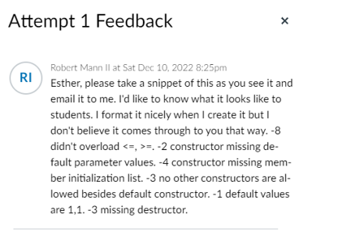
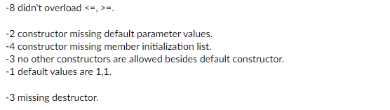
formatting is alright if we view from ‘Grade’ menu but this is what we get when we click on ‘Assignment->View feedback’ menu.

